Slide 1
Data discretization in data mining

Slide 2
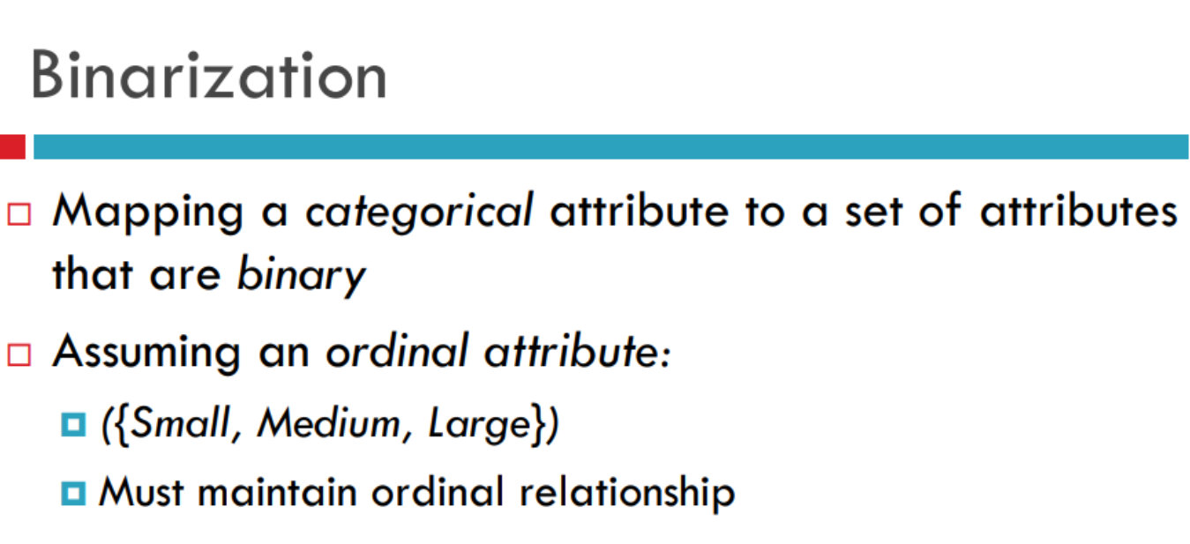

Slide 4
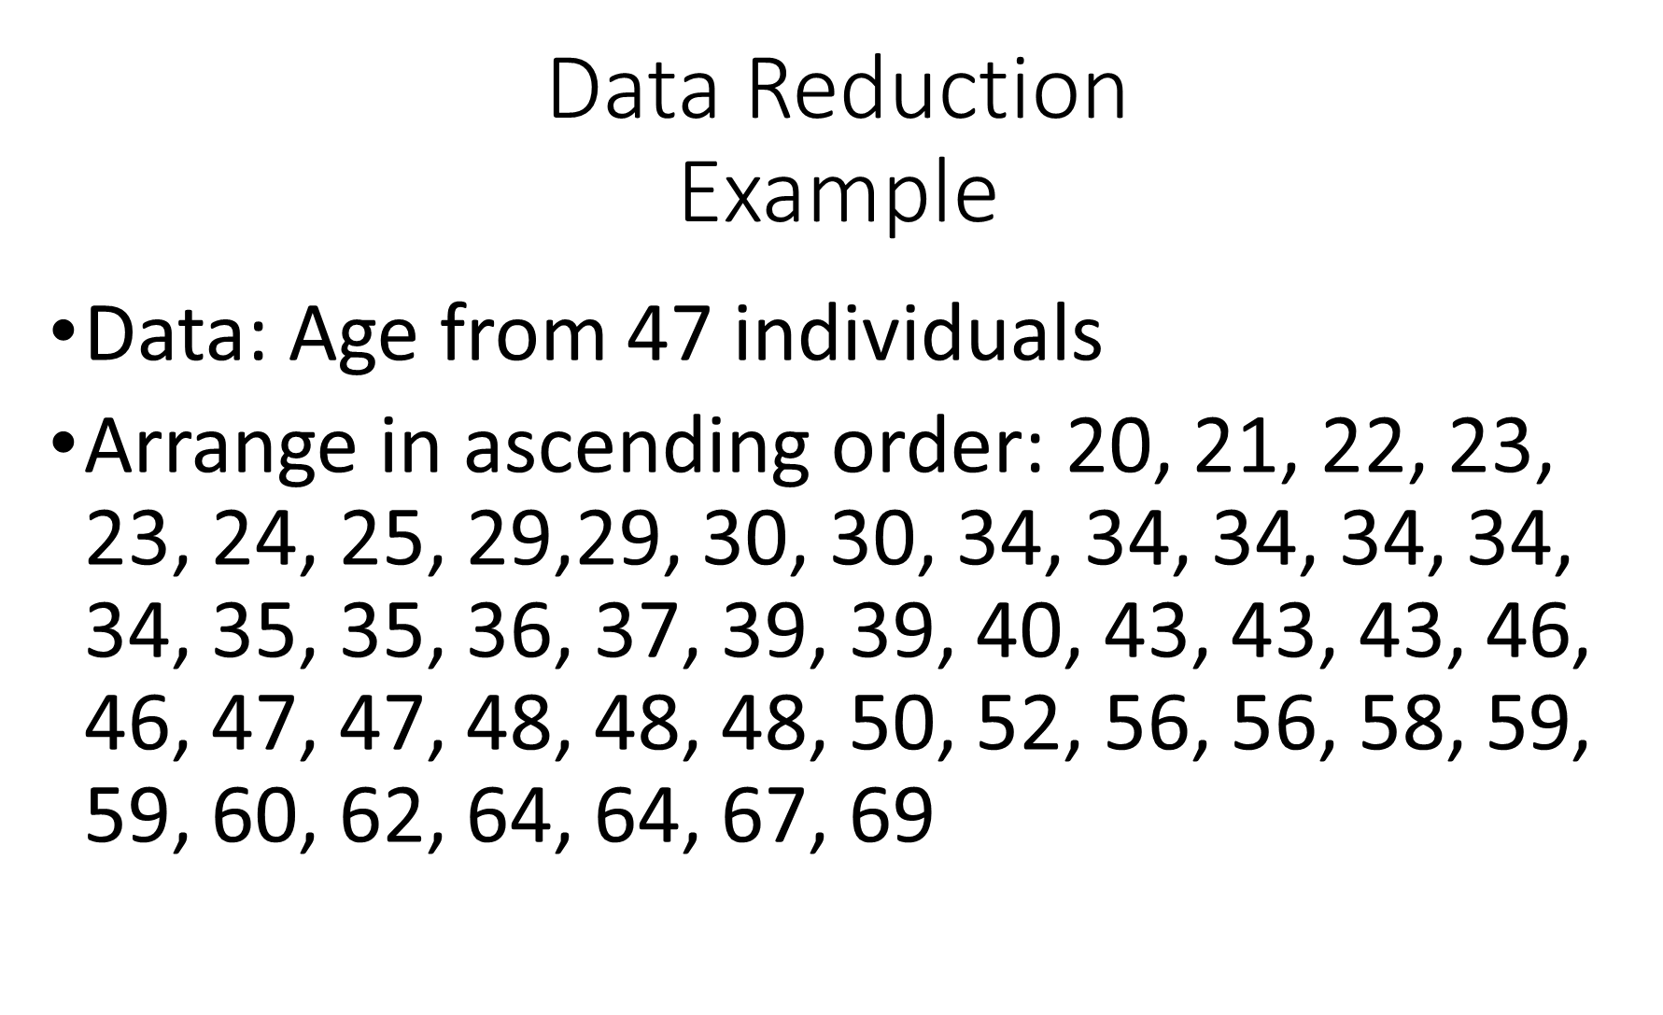

Slide 5
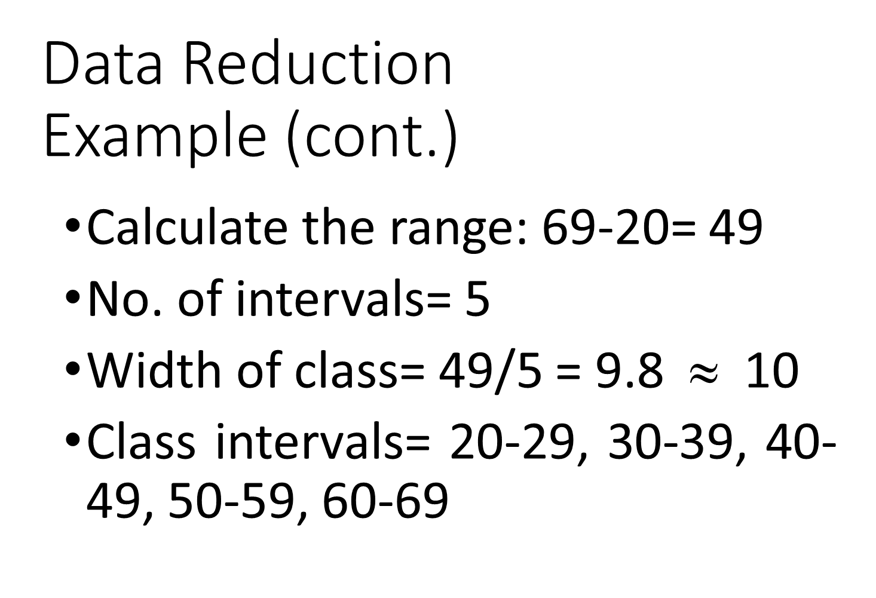

Slide 6
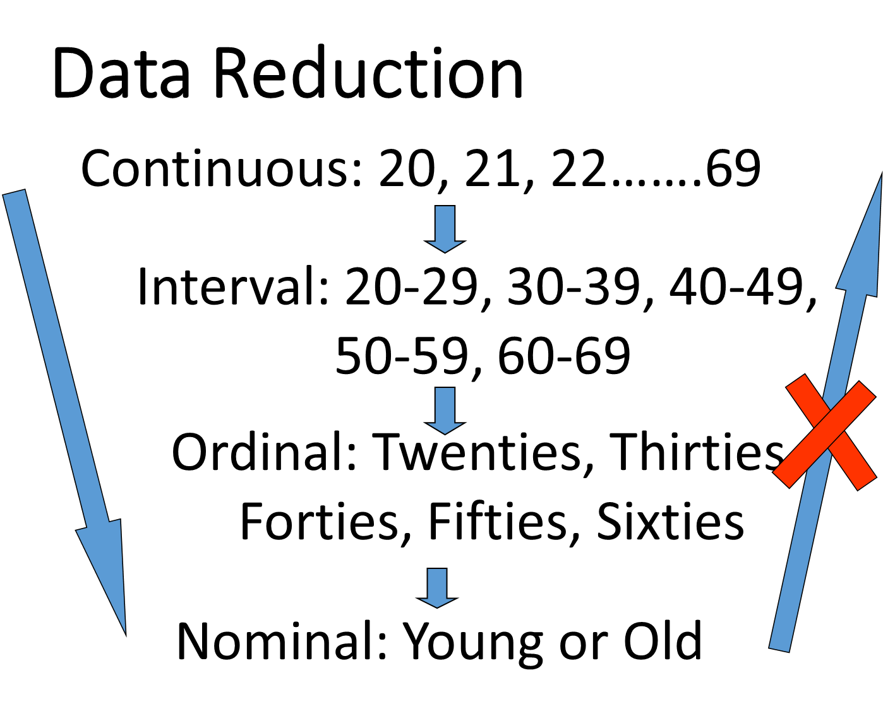

Slide 7



Data Transformation: Normalization
Min-max normalization: to [new_min_{A}, new_max_{A}]
Ex. Let income range $12,000 to $98,000 normalized to [0.0, 1.0]. Then $73,000 is mapped to
Z-score normalization (μ: mean, σ: standard deviation):
Ex. Let μ = 54,000, σ = 16,000. Then
Normalization by decimal scaling
Where j is the smallest integer such that Max(|ν’|) < 1

Slide 8
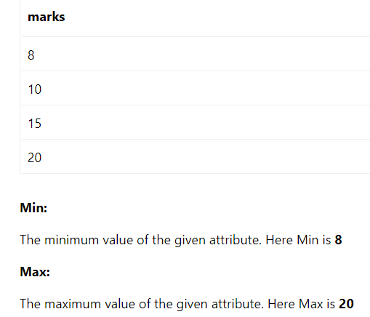

Slide 10
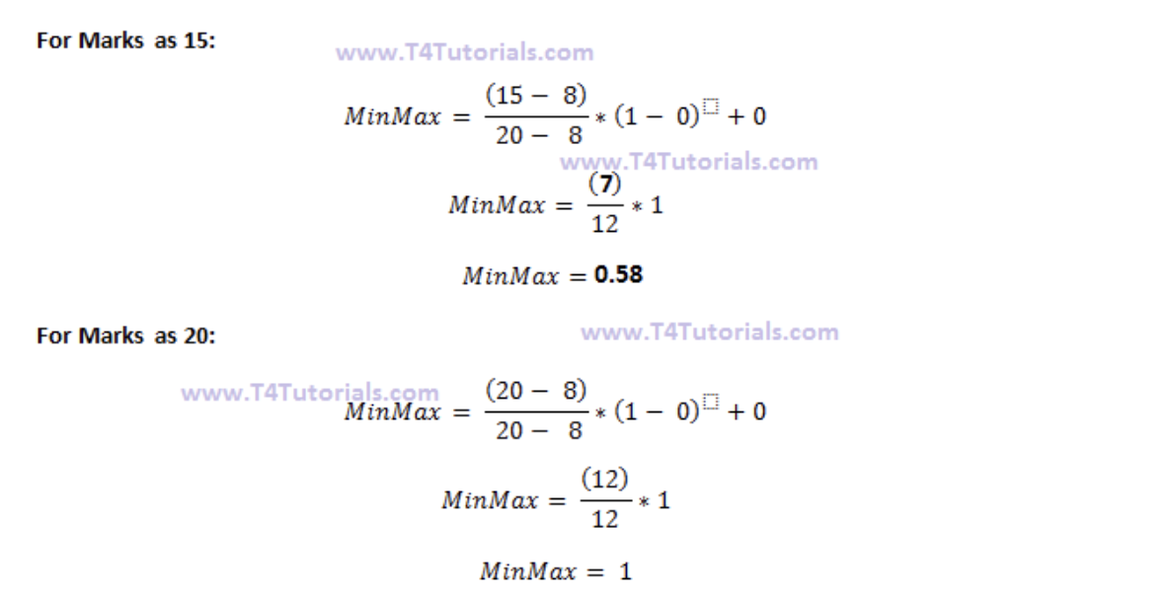
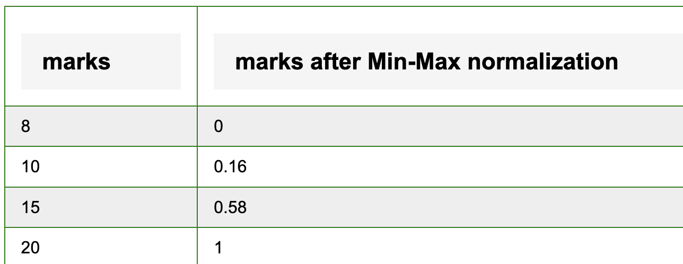

Slide 11
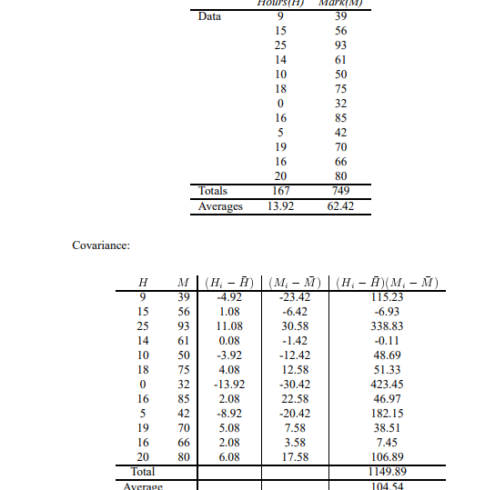

Slide 12
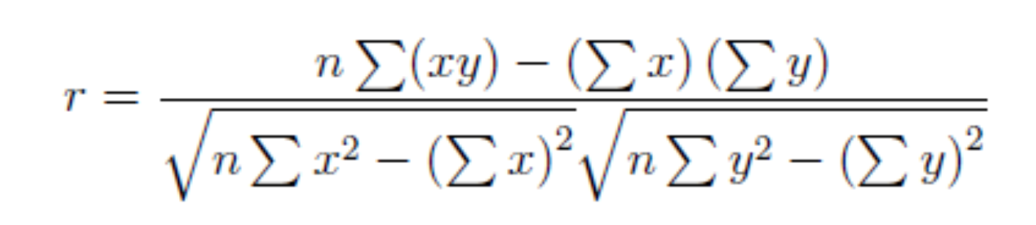

Slide 13


Co-Variance: An Example
It can be simplified in computation as
Suppose two stocks A and B have the following values in one week: (2, 5), (3, 8), (5, 10), (4, 11), (6, 14).
Question: If the stocks are affected by the same industry trends, will their prices rise or fall together?
E(A) = (2 + 3 + 5 + 4 + 6)/ 5 = 20/5 = 4
E(B) = (5 + 8 + 10 + 11 + 14) /5 = 48/5 = 9.6
Covariance(A,B) = (2×5+3×8+5×10+4×11+6×14) / 5 − (4 × 9.6) = 4
Thus, A and B rise together since Cov(A, B) > 0.

